Slide 1

An Introduction to
Centennial High School
Information for Parents/Guardians

Slide 2
Welcome
Principal: Joe Sturgeon

Slide 3
Transitioning from Junior High to Successful High School Student
Freedom & Responsibility
Attendance – believe those phone calls!
Monitoring progress on PowerSchool – students and families
Meet new friends - not all the same Junior High friends in your classes
Experience and try new things

Slide 4
Who is here to help?
Surnames | Guidance Counsellor | Assistant Principal
A-G | Mx. Mead | Mr. Pierpoint
H-N | Ms. Minhas | Ms. Banack
O-Z | Ms. Hunter | Ms. Kasumovich
IPP Coordinator: Ms. Ruault EAL Support: Ms. Bhathal & Ms. Aguinaldo Indigenous Student Grad Coach: Ms. MacAskill All In For Youth Success Coach: Mr. Ieuan Roberts

Slide 5
High School Diploma Credits & Minimum Courses
Total 100 credits (minimum)
Grade 10 40 credits (8 classes)
Grade 11 38 credits (7.5 classes)
Grade 12 35 credits (7 classes)

Slide 6
Alberta High School Diploma Requirements
Total 100 credits
English 30 level
Social 30 level
Science 20 level
Math 20 level
PE 10
CALM 20 (Career & Life Management)
10 credits in options
10 additional credits 30 level

Slide 7
Certificate of High School Achievement Requirements
Total 80 credits (minimum)
Earned by students in Knowledge & Employability (KAE)
Placement in these courses is by referral with junior high school, parent/guardian & counsellor
Less academically demanding - greater focus on hands-on experiential activities
Provides successful transition into employment/further training opportunities
May transition to high school diploma courses

Slide 8
Courses & Credits
Each class/period = 5 credits
(4 classes per day = 20
credits per semester)
Credit is earned with a mark of 50%+
Course levels for Grade 10 are numbered as 10/15, for Grade 11 as 20/25, and for Grade 12 as 30, 35

Slide 9
Grade 10 Course Registration
Four academic courses:
    English, Social Studies, Math, & Science
Physical Education 10
Three complementary/option courses (will also choose two alternates)
Timetable Example for Each semester:
    2 academics + 2 complementary/option
    2 academics + 1 complementary + P.E. 10

Slide 10

Sample Grade 10 Timetable
 | MON | TUES | WED | THURS |  | FRI
J Block Classes 7:00-8:40am
Tutorial Time 8:40-9:05am
9:09-10:33 | 1 Drama 10 | 2 ELA 10-1 | 1 Drama 10 | 2 ELA 10-1 | 9:09-10:02 | 1 Drama 10
10:37-12:01 | 2 ELA 10-1 | 1 Drama 10 | 2 ELA 10-1 | 1 Drama 10 | 10:06-10:59 | 2 ELA 10-1
Lunch 12:01-12:39 |  |  |  |  | Nutrition Break 10:59-11:21
12:43-2:07 | 3 PE 10 | 4 Math 10-C | 3 PE 10 | 4 Math 10-C | 11:25-12:18 | 3 PE 10
2:11-3:35 | 4 Math 10-C | 3 PE 10 | 4 Math 10-C | 3 PE 10 | 12:22-1:15 | 4 Math 10-C
After School Classes 3:35-5:00 |  |  |  |  | No Scheduled Contact Friday afterschool
Please note that our bell schedule is subject to change before the beginning of September 2024

Slide 11
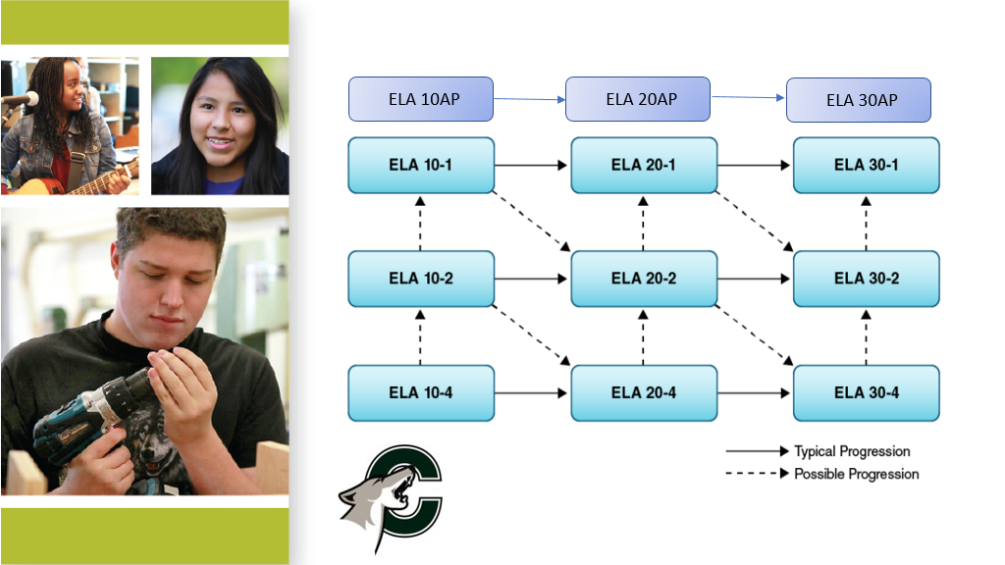
English Language Arts Pathways

Slide 12
Social Studies Pathways

Slide 13
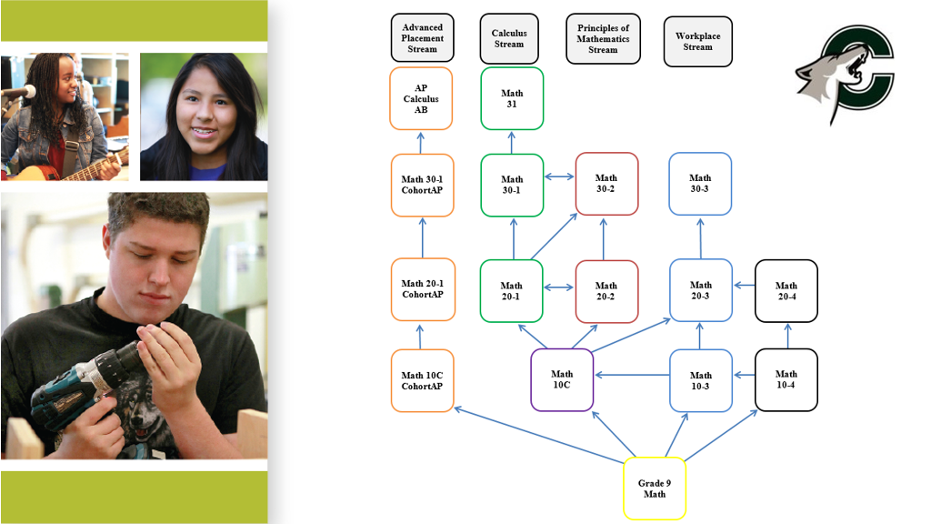
English Language Arts
Mathematics Pathways

Slide 14
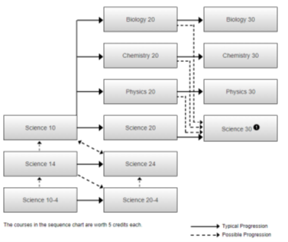
Science Pathways

Slide 15
Need More Information?
Course Registration Guide
School Web Site
    www.schools.cbe.ab.ca/b870
Consult with Junior High Staff
Centennial Open House – January 29, 2026 from 7:00-9:00pm (doors open at 6:30pm)
Centennial Guidance Counsellors will visit some Junior Highs to meet & register students individually

Slide 16

Contacts
Satnaum Mead (Guidance Counsellor A-G)
  srmead@cbe.ab.ca
Manpreet Minhas (Guidance Counsellor H-N)
  mkminhas@cbe.ab.ca
Lynda Hunter (Guidance Counsellor O-Z)
  lmhunter@cbe.ab.ca
Lesley Ruault (IPPs)
  laruault@cbe.ab.ca
Kalyn MacAskill (Indigenous Student Graduation Coach)
  kmmacaskill@cbe.ab.ca
Nicola Wilson (K&E)
  nmwilson@cbe.ab.ca
Joe Sturgeon (Principal)
  jisturgeon@cbe.ab.ca
Stu Pierpoint (Assistant Principal A-G)
  srpierpoint@cbe.ab.ca
Pam Banack (Assistant Principal H-N)
  pmbanack@cbe.ab.ca
Martina Kasumovich (Assistant Principal O-Z)
  mskasumovich@cbe.ab.ca

Slide 17

Thank you!!!

